Slide 1
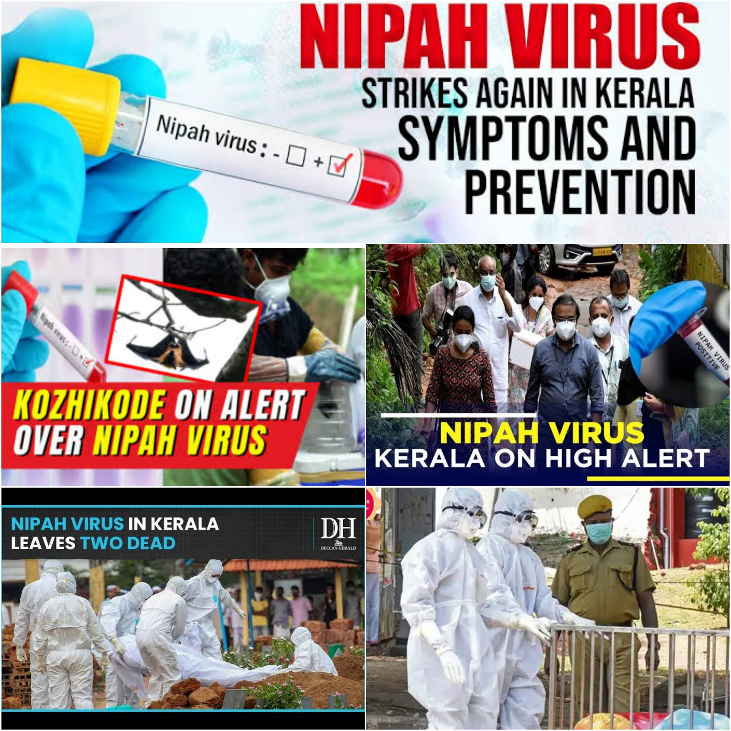
Understanding Nipah Virus:
A Deadly Zoonotic Pathogen

Slide 2
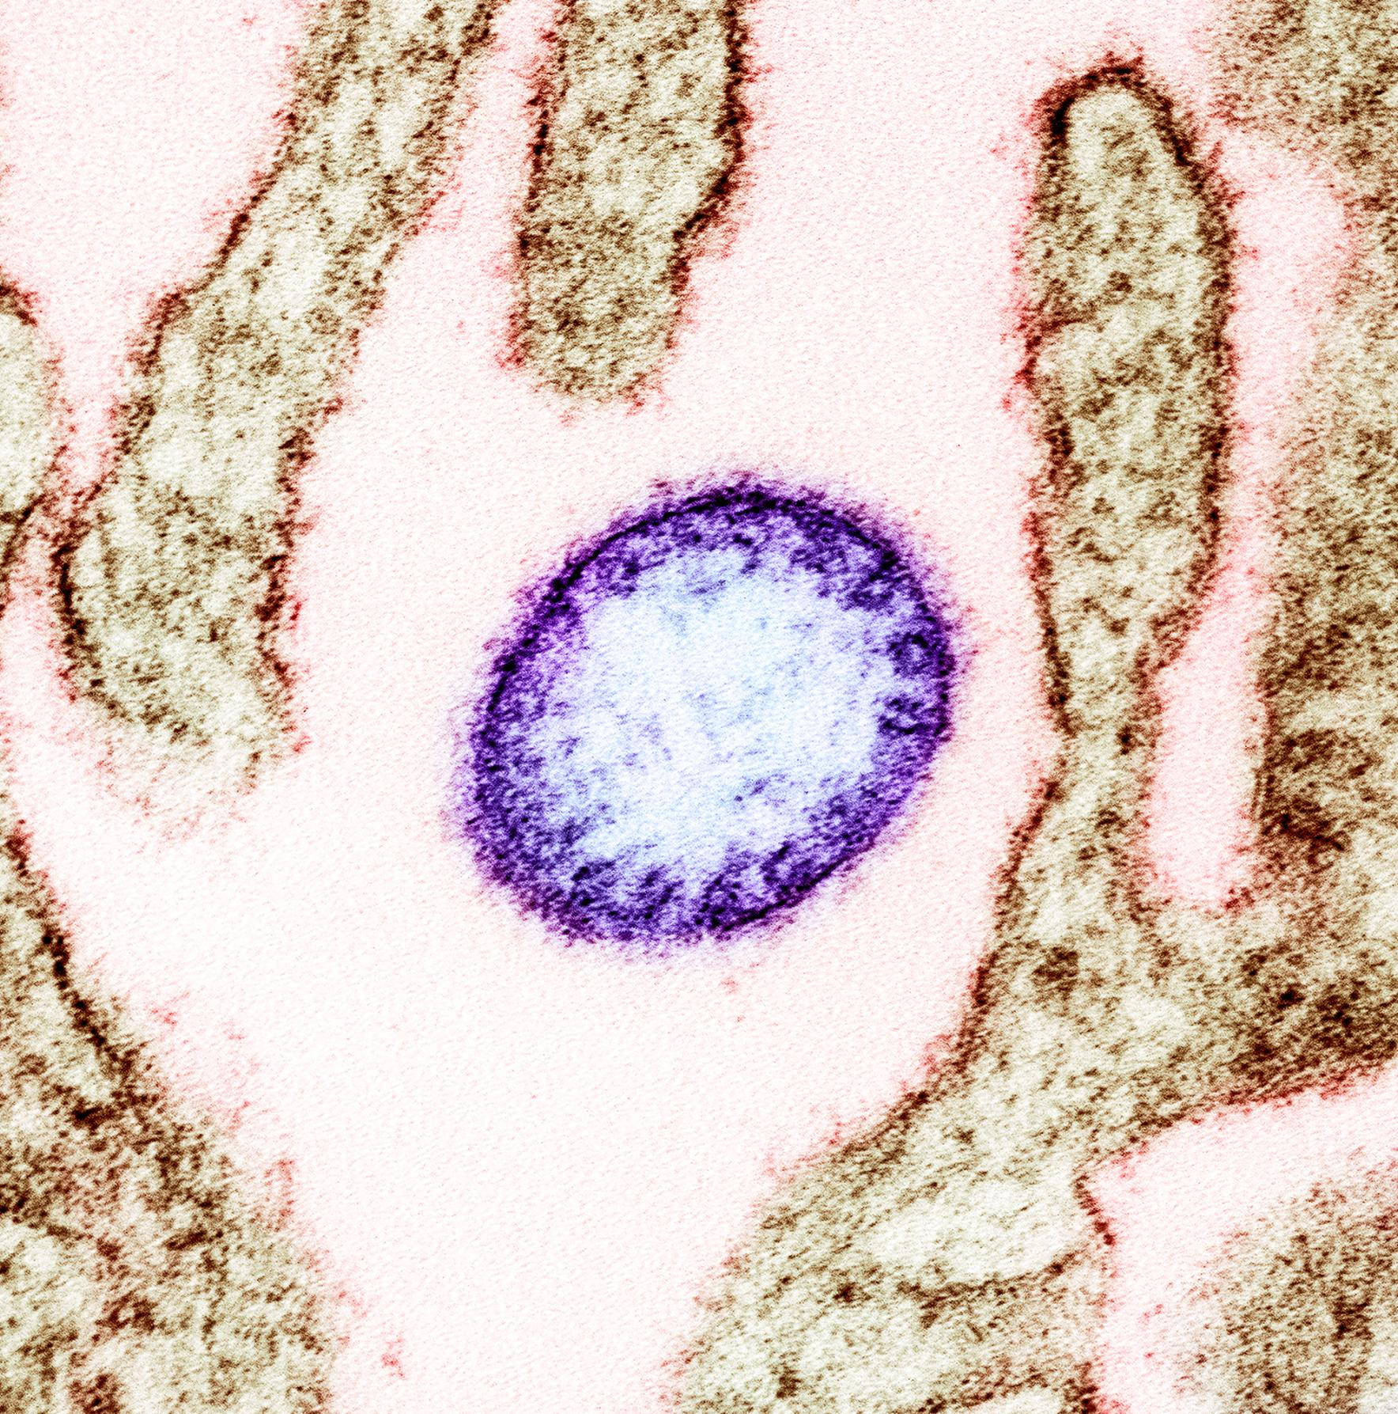
INTRODUCTION
Nipah is a zoonotic RNA virus belonging to the Paramyxoviridae family under the genus Henipavirus
Initially discovered when it caused an outbreak of viral encephalitis among pig farmers in Malaysia in 1998-1999

Slide 3
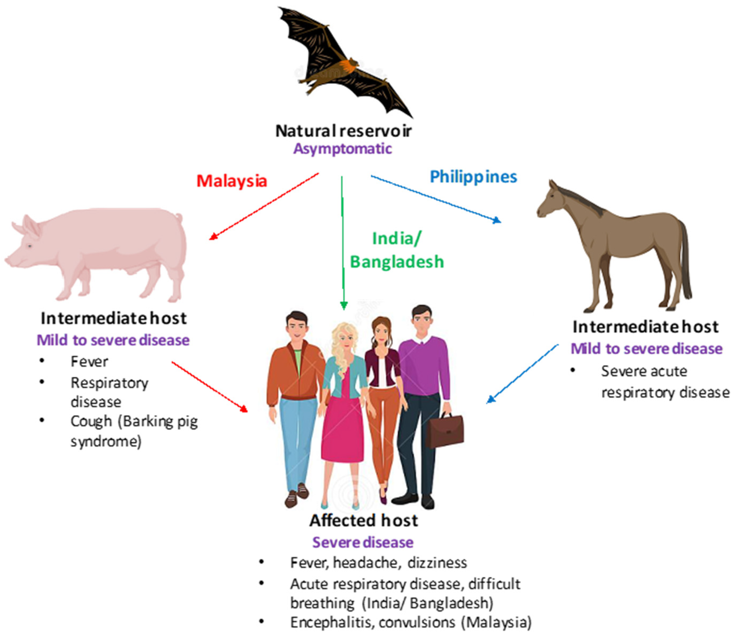
Primary Animal Reservoir
Fruit Bats / Flying Foxes
Intermediate Host
Pigs, Cats, Dogs, Horses

Slide 4
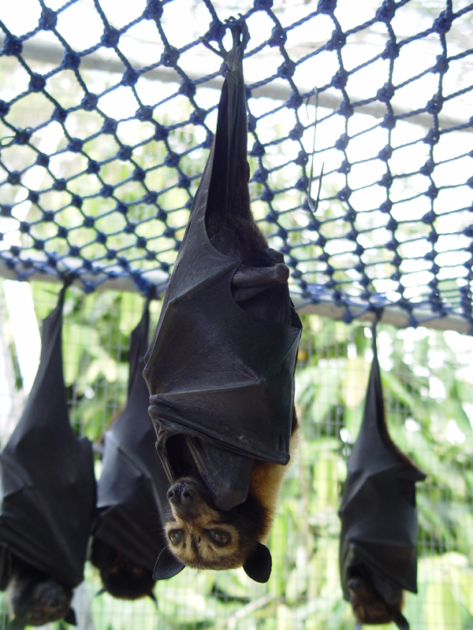
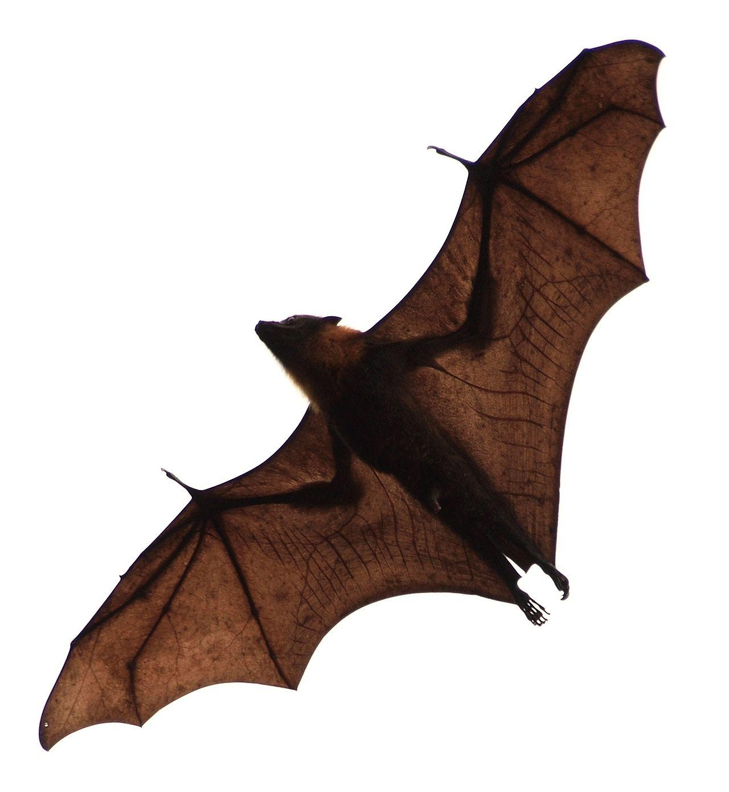
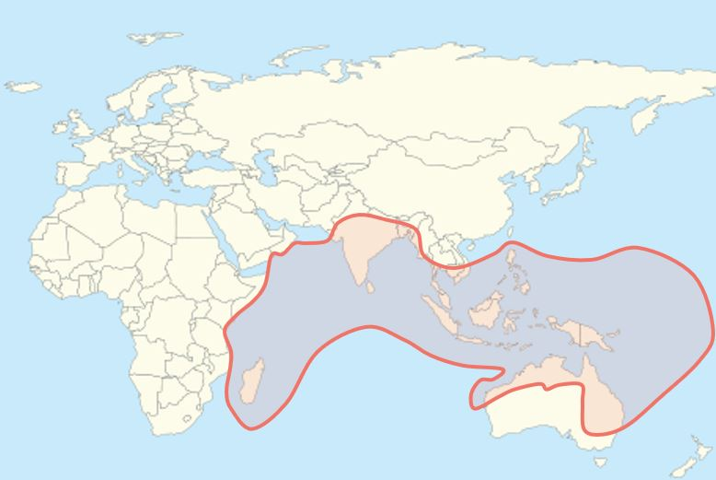
Fruit bats, also called flying foxes, are the animal reservoir for NIPAH VIRUS in nature
Geographic Distribution of Pteropus - NIPAH BELT

Slide 5
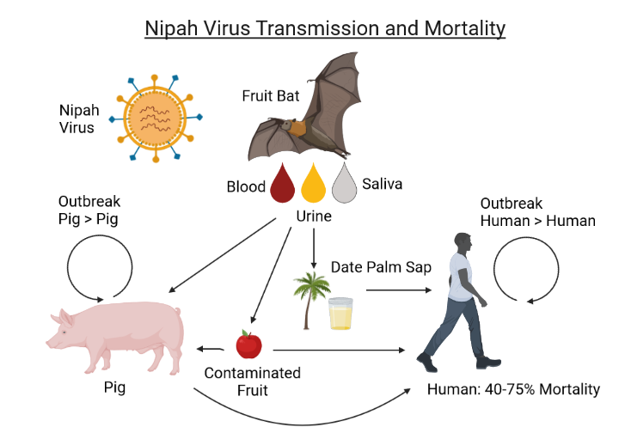
TRANSMISSION
DIRECT CONTACT with body fluids (Blood, Urine or Saliva) of infected animals
CONSUMING FOOD PRODUCT - palm sap or fruit contaminated by an infected bat
CLOSE CONTACT with infected person or their body fluids (respiratory droplets, urine, or blood)

Slide 6
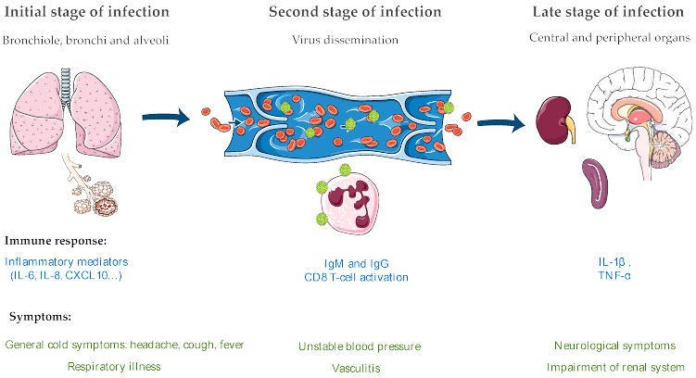
PATHOGENESIS

Slide 7
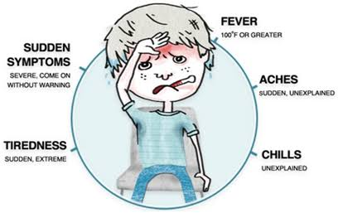
CLINICAL FEATURES
Incubation Period : 6-21 days
Fever, Altered mental status, Severe weakness, Headache, Respiratory distress, Cough, Vomiting, Muscle pain, Convulsion, Diarrhoea
Syndromic Presentations - ARDS, Myocarditis and Encephalitis.
Encephalitis and seizures occur in severe cases, progressing to coma within 24 to 48 hours.
Patients can present with fever alone
Any patient coming with fever & any other symptom with an epidemiological link & contact H/O must be treated as NiV infection

Slide 8
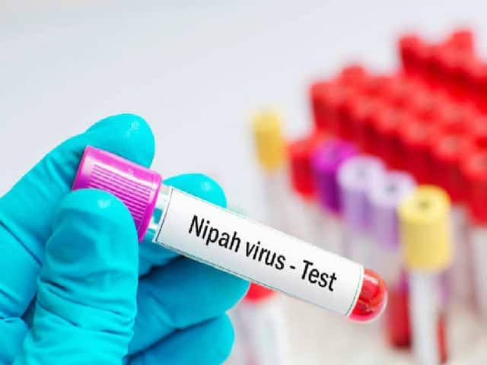
DIAGNOSIS
DEFINITIVE DIAGNOSIS
Demonstration of Virus in body fluids : RT-PCR Viral RNA
Not done routinely - BIOSAFETY LEVEL 4
SEROLOGICAL TESTING
IgM ELISA - First line Serological Diagnostic Test
Confirmatory - Detection of Neutralizing Antibodies against Nipah virus in serum

Slide 9
TREATMENT
NO APPROVED DRUG SO FAR
Standard care must be provided as in any other infection presenting with Encephalitis, ARDS, and or Myocarditis.
Available Options - Ribavirin / Monoclonal antibody m102.4

Slide 10
m102. 4 - Monoclonal Antibody
m102.4 binds to the immunodominant NiV receptor-binding glycoprotein (GP), and neutralizes NiV,
The compassionate use has been approved by the government, it will be the choice of the patient and their family whether they take it.
There have been no trials because several cases of the infection are needed to do so.

Slide 11
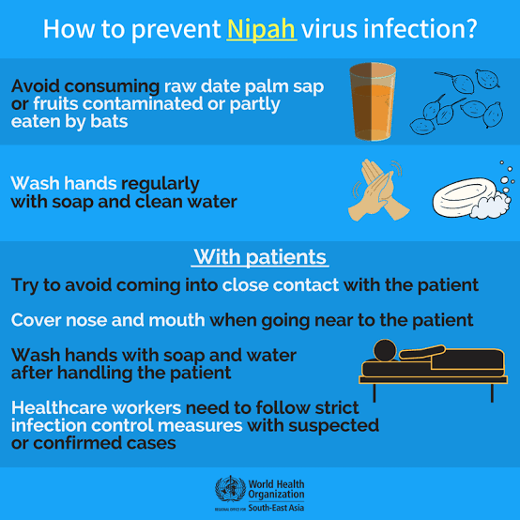
PREVENTIVE MEASURES
Practice handwashing regularly with soap and water
Avoid contact with sick bats or pigs
Avoid areas where bats are known to roost
Avoid eating or drinking products that could be contaminated by bats, such as raw date palm sap, raw fruit
Avoid contact with the blood or body fluids of any person known to be infected with NiV

